Slide 1
South Florida Multifamily Market Overview
Recap of 2017 and Trends for 2018
2018 CCIM Commercial Real Estate Outlook Conference
January 17, 2018

Slide 2
South Florida Multifamily Supply & Demand

Slide 3
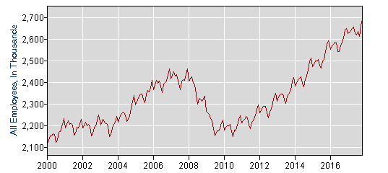
Jobs Jobs & More Jobs
South Florida Job Growth
South Florida has added 574,000 jobs since January 2000
232,000 more jobs in South Florida than prior peak in December of 2007
545,000 jobs created since trough of the prior cycle in July of 2010
Miami-Dade, Broward, and Palm Beach Counties all have unemployment rates at or near historic lows
Source: US Department of Labor and Statistics

Slide 4
Florida Driven by Population Growth
25 Million People in 2030
900 per day or
328,000 per year
5 Million people added since 2000
* Source: University of Florida Bureau of Economic and Business Research

Slide 5
Population is Booming in South Florida
South Florida Population Growth 230 per day
Or
83,950 per year
250,000 are expected by 2020, 1 million people added since 2000
* Source: University of Florida Bureau of Economic and Business Research

Slide 6
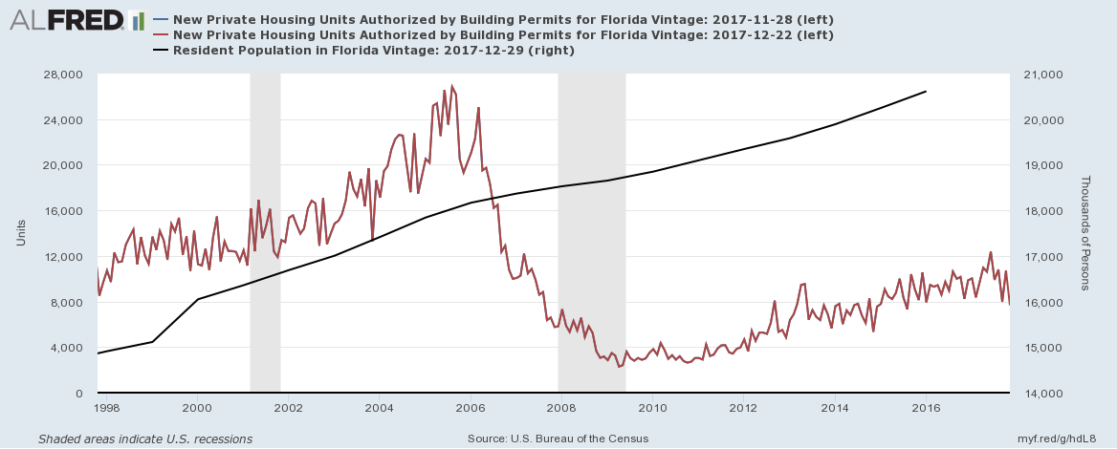
Household Size Trends
Household size will be the key variable impacting housing demand in the future
Housing production remains limited and lower than averages over the last 30 years
Demand continues to outpace supply
* Source: University of Florida Bureau of Economic and Business Research

Slide 7
Total Housing Production
32,041 Implied Demand
18,362 annual average of Housing Permits
(2005 to 2016)
South Florida:
83,950 annual population growth per year
2.62 people per household
32,041 Housing Units required per year
16,120 Units per year since 2010
(Under Supplied)
5,822 Single Family Permitted per year since 2010
(Lack of Land)
18,362 Average
Includes: for rent and for sale (including low income housing)

Slide 8
South Florida Multifamily Investor Demand

Slide 9
South Florida Multifamily Cap Rate Trends
New & Core Communities
<4.00% to 5.25%
A & B+ Class Communities
4.50% to 5.50%
B- & C Class Communities
5.00% to 5.75%
Cap rates remain low relative to amortized debt constants and historical metrics due to:
Stable property fundamentals
Low long term rates
Interest only debt terms
Lack of yield alternatives

Slide 10
Target Returns: 5.5% to 7.5% Unlevered IRRs
Investor Profiles: Core & Institutional
Focused on quality assets in AAA locations
Low single digit cashflow going in
Long term stability and rent growth expectations
Value relative to Replacement cost
No leverage required, but may use 30% to 50% post-close
Examples: REITs, Pension Funds, Sperate Account Advisors, Sovereign Wealth Funds, and Life Companies

Slide 11
Investor Profiles: Core Plus & Value-Add
Utilize fixed or floating rate agency (Fannie/Freddie) debt (65% to 80%)
Maximize interest only terms available (recent lift from “Green Rewards” program pricing)
Focused on overall returns including reversion (sale), not year one cashflow
Value relative to the discount to replacement cost
Leverage capital improvements to grow rents at an accelerated rate to grow Net Operating Income
Examples: Private Equity Funds, Syndicators, Sperate Account Advisors, Delaware Statutory Trusts, Smaller Public, Private and Canadian REITs
Target Returns: 11.0% to 14.0%
Levered IRRs

Slide 12
Investor Profiles: High Net Worth & Private Investors
Utilize fixed rate debt (60% to 80%) from banks, agencies, and CMBS
Interest only terms critical to the business plan
Focused on year one levered free cashflow (8.0% to 10.0% minimum)
Lack of yield investment alternatives
Ability to hire institutional grade third party property management (low barrier to entry)
Examples: Private Investors, Family Offices, Foreign Investors, 1031 Buyers, and Syndicators
Target Returns: 12.0% to 16.0%
Levered IRRs

Slide 13
10 Year Treasury Rate - Drives Pricing
US 10-Year Treasury Rate: is the key benchmark for multifamily lending rates
2.43%
End of 2017

Slide 14
Yield 8.0% on a 5.0% Cap with fixed rate debt? INTEREST ONLY
Assumptions Monthly Rent: $1,200 Vacancy & Credit Loss: 6.5% Other Income: 4.0% of Monthly Rent Expense Ratio: 46.0% Revenue: $14,040 Expenses: $6,458 NOI: $7,582 | Acquisition & Debt Service (per Unit) Loan Rate: 4.0% Loan-to-Value: 75% Interest Only: 5 years Cap Rate: 5.0% Value: $151,632 Debt: $113,724 Equity: $37,908 | Cash-on-Cash Returns Year One Debt Service: $4,549 Year One Interest Only Returns NCF: $3,033 ROE: 8.00% Amortized Debt Returns (30 Year) NCF: $1,066 ROE: 2.81%

Slide 15
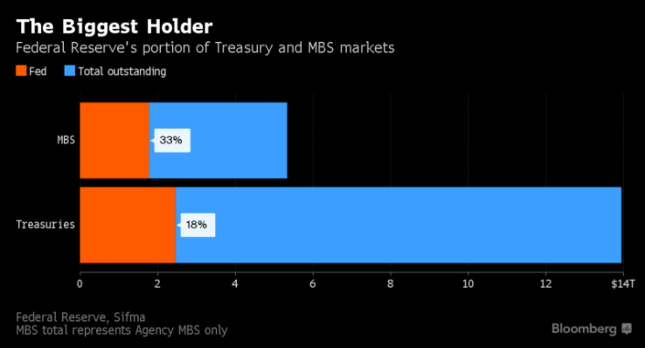
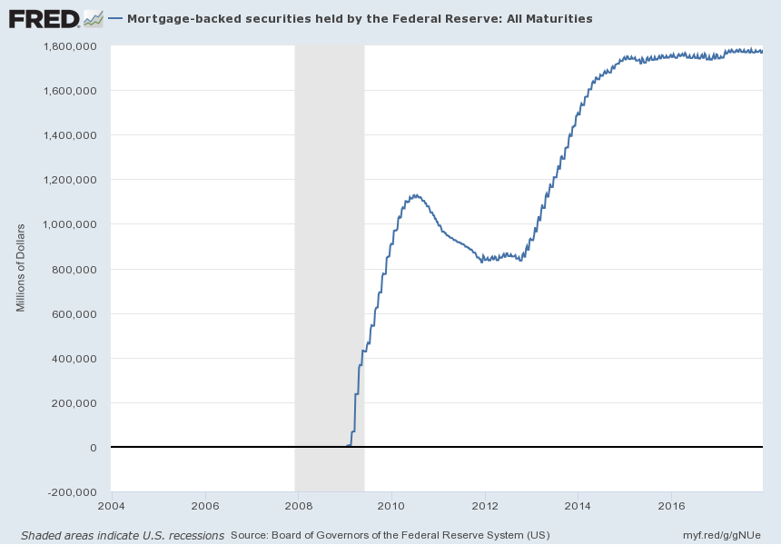
Federal Reserve Balance Sheet and Mortgage Backed Securities (MBS)
The Fed owns 33% of ALL Mortgage Backed Securities
The Fed owns 33 % of all outstanding Mortgage Backed Securities
Capital markets could be impacted if the Fed is tapering MBS and long term interest rates rise?

Slide 16
South Florida Multifamily Transaction Profiles

Slide 17
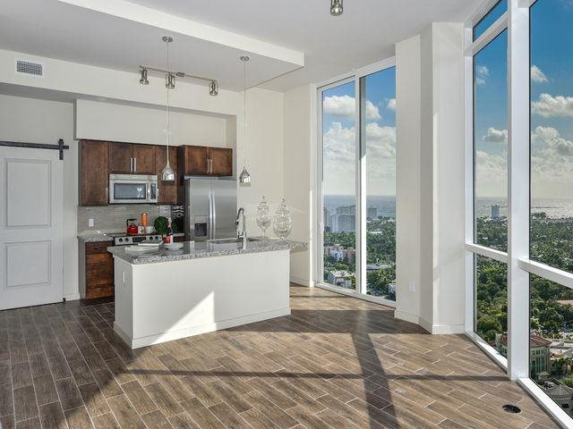
Recent Sales of
New Communities
Amaray Las Olas – Fort Lauderdale
Sold June 2017
254 Units – Built in 2016
$133,550,000 / $525,787 per Unit / $468 per Foot
Buyer: GID - $13 Billion AUM
850 Boca – Boca Raton
Sold December 2017
370 Units – Built in 2017
$138,000,000 / $372,973 per Unit / $326 per Foot
Buyer: Avalon Bay - $25 Billion Market Cap REIT
Manor CityPlace – Doral
Sold August 2017
400 Units - Built in 2015
$135,000,000 / $337,500 per Unit / $357 per Foot
Buyer: TA Associates Realty $11 Billion AUM

Slide 18
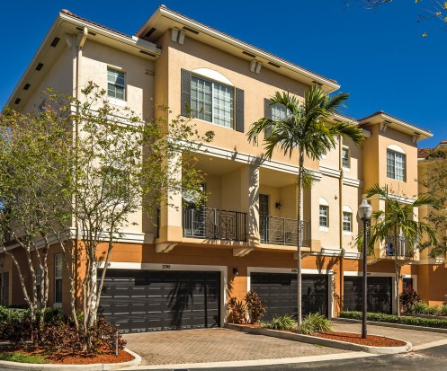
Recent Sales of
10 to 15 Year Old Communities
Solano at Miramar – Miramar
Sold September 2017
517 Units – Built in 2006
$119,750,000 / $233,887 per Unit / $201 per Foot
Buyer: Pollack Shores (Crow Holdings) - $11 Billion AUM
San Merano at Mirasol – Palm Beach Gardens
Sold April 2017
476 Units – Built in 2002
$103,6000,000 / $217,647 per Unit / $175 per Foot
Buyer: LivCor (Blackstone) – $110 Billion AUM

Slide 19
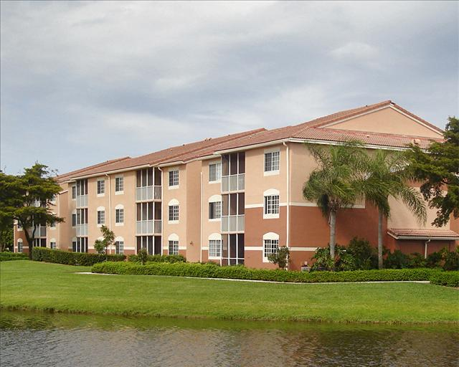
Recent Sales of 1990s Built Communities (20 to 30 Years Old)
Atlantic at East Delray – Delray Beach
Sold August 2017
228 Units – Built in 1996
$54,325,000 / $238,268 per Unit / $210 per Foot
Buyer: TIAA - $97 Billion AUM
Delray Verana – Delray Beach
Sold August 2017
488 Units – Built in 1990
$102,500,000 / $210,041 per Unit / $176 per Foot
Buyer: Bainbridge Companies - 25,000 unit owner
Laurels at Jacaranda – Plantation
Sold June 2017
468 Units – Built in 1990
$93,000,000 / $198,718 per Unit / $216 per Foot
Buyer: TIAA - $97 Billion AUM

Slide 20
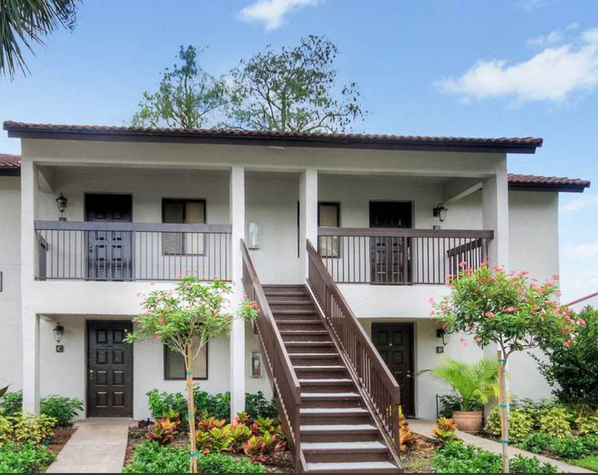
Recent Sales of
1980s Built Communities
(30 to 35 Years Old)
Landings at Coconut Creek – Coconut Creek
Sold August 2017
268 Units – Built in 1986
$45,300,000 / $169,030 per Unit / $202 per Foot
Buyer: TIAA - $97 Billion AUM
Lago Paradiso – Miami
Sold June 2017
424 Units – Built in 1987
$60,810,000 / $143,426 per Unit / $201 per Foot
Buyer: Robbins Electra – 23,000 unit owner
Pinebrook Pointe – Margate
Sold May 2017
394 Units - Built in 1988
$69,900,000 / $177,411 per Unit / $160 per Foot
Buyer: LivCor (Blackstone) – $110 Billion AUM

Slide 21
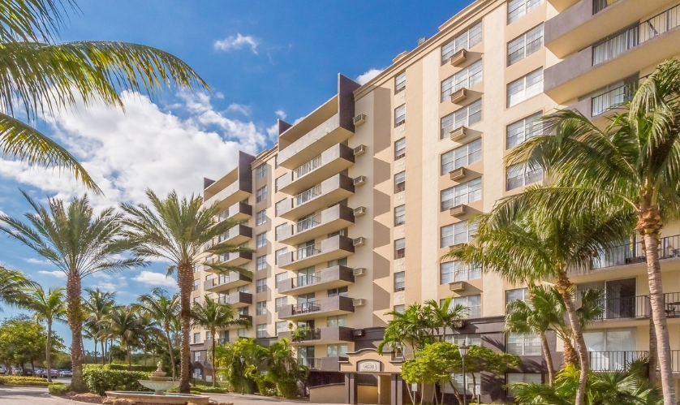
Recent Sales of
1970s Built Communities
(Over 40 Years Old)
Rio - Miami
Sold March 2017
295 Units – Built in 1971
$42,000,000 / $142,373 per Unit / $183 per Foot
Buyer: Grand Peaks Properties - 8,000 unit owner
Aliro – North Miami
Sold July 2016
867 Units – Built in 1974
$117,000,000 / $134,948 per Unit / $172 per Foot
Buyer: LivCor (Blackstone) – $110 Billion AUM

Slide 22
South Florida Multifamily Fundamentals

Slide 23
South Florida Multifamily Average Rents & Occupancy
Market | Average Rent | Rent Per Sq. Ft. | Average Occupancy
Fort Lauderdale | $1,547 | $1.55 | 94.5%
Miami | $1,602 | $1.78 | 96.2%
West Palm Beach – Boca Raton | $1,590 | $1.54 | 93.8%
Ft. Lauderdale CBD has exhibited rents exceeding $3.00 Per Sq. Ft. in high-rise product
Source: Yardi®Matrix - Data as of Q4 2017

Slide 24
Workforce Units Continue to Outperform the Rest
South Florida Multifamily Rent Growth
Year-over-year rent growth for Fort Lauderdale, Miami and West Palm Beach - Boca Raton markets
Source: Yardi®Matrix

Slide 25
Average Across South Florida 2014 - $1,300 2017 - $1,550 (4.5% growth compounded over 4 Years)
South Florida Rental Rate Trends
Source: Yardi®Matrix

Slide 26
South Florida Multifamily Fundamentals remain strong
New Supply is Impacting Fundamentals
Annual rent growth trend was 4.0% to 7.0%, decelerated to 2.0% to 4.0%
Occupancies ranged from 96% to 98%, down slightly to 94% to 95%
Workforce apartments remain very strong with minimal vacancy and strong rent growth
Upper tier communities are holding their ground, but not generating as much rent growth as they contend with new supply’s short term disruption

Slide 27
Rent and Occupancy Trends: South Florida
Current Occupancy
Miami : 94.4%
Fort Lauderdale: 94.4%
West Palm: 94.2%
Current Rent Growth
Miami : 1.9%
Fort Lauderdale: 2.2%
West Palm: 2.0%
Source: Yardi®Matrix

Slide 28
Forecasted Rent and Occupancy: South Florida
Occupancy projected to remain stable
Rent Growth projected to grow slightly
Source: Yardi®Matrix
Source: Yardi®Matrix

Slide 29
South Florida Multifamily New & Emerging Trends

Slide 30
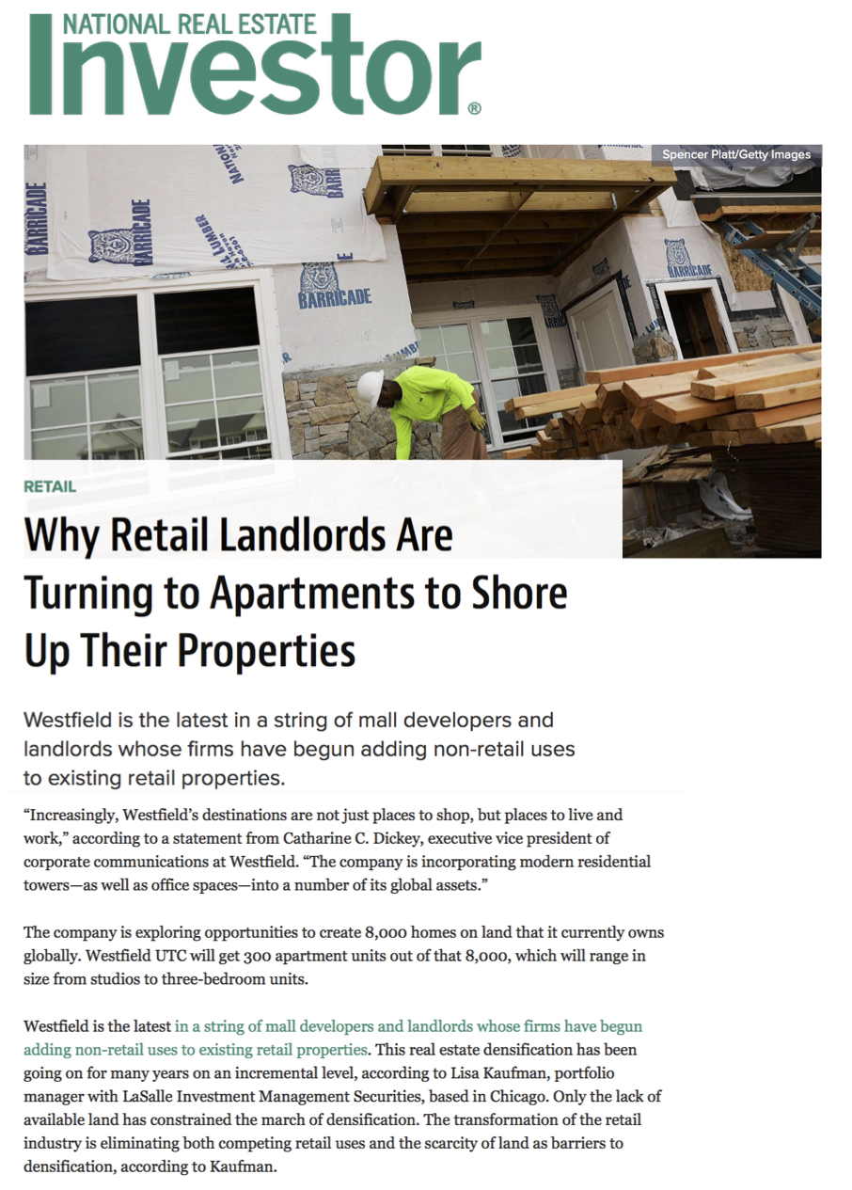
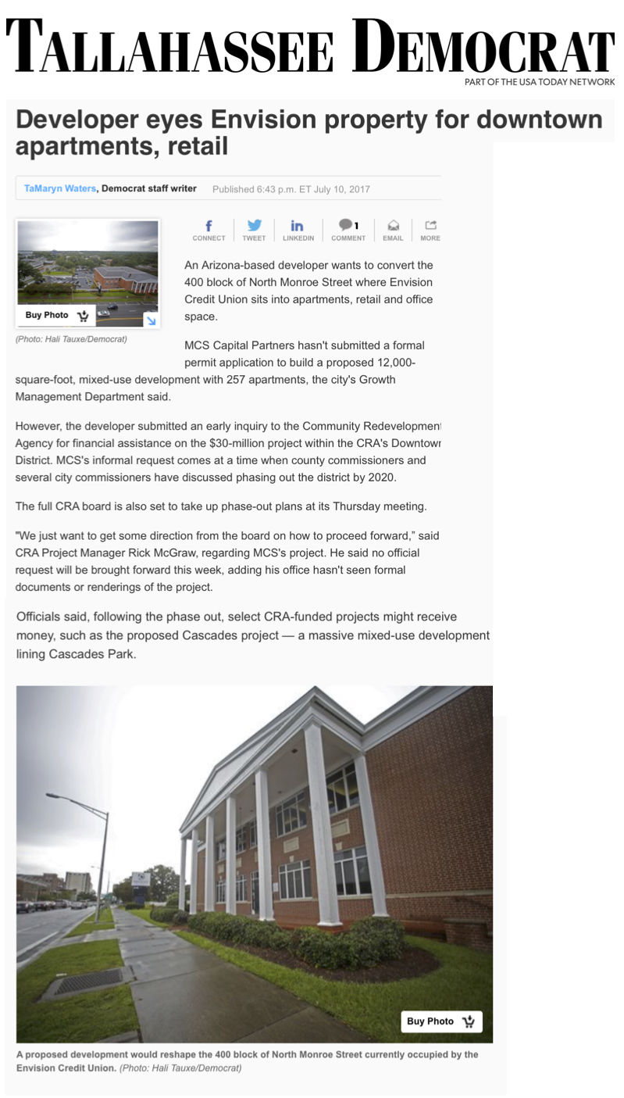
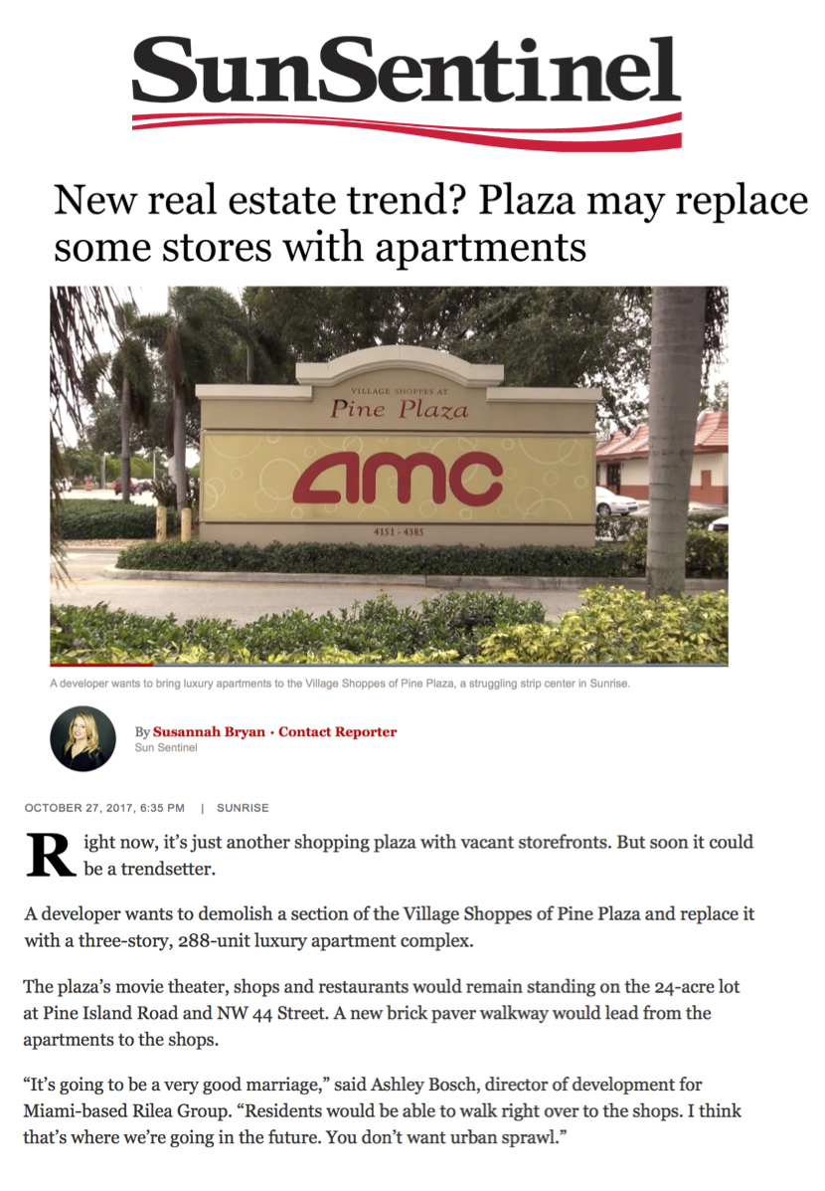
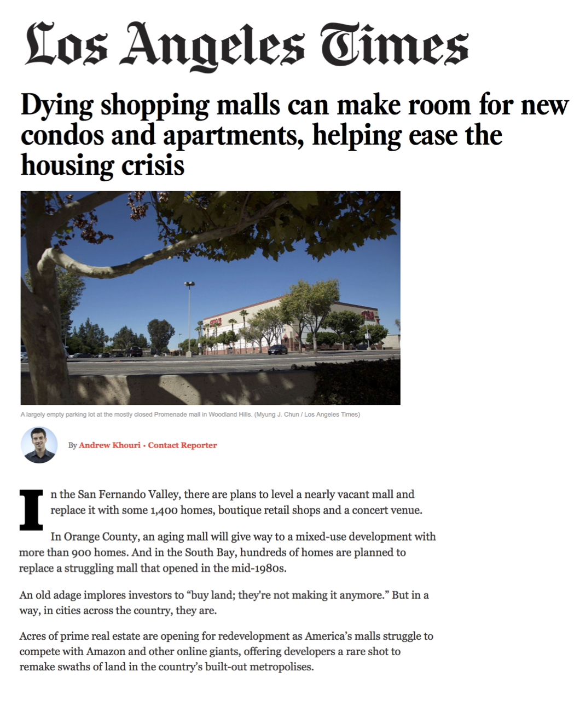
Investors Get Creative … Turning to Multifamily to Generate Returns
Shopping Centers and Office Complexes Redeveloped Into Multifamily

Slide 31
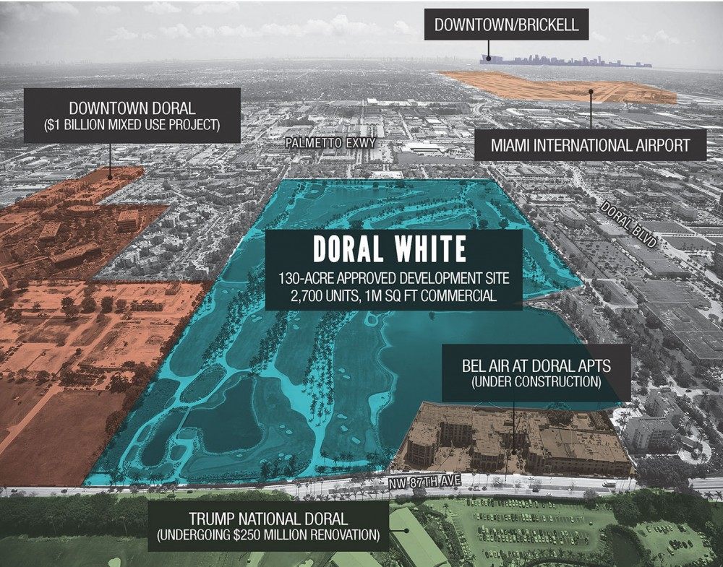
Last Frontier of Land for Housing The Golf Course
How will golf courses impact the housing market?
Should we adjust our expectations?

Slide 32
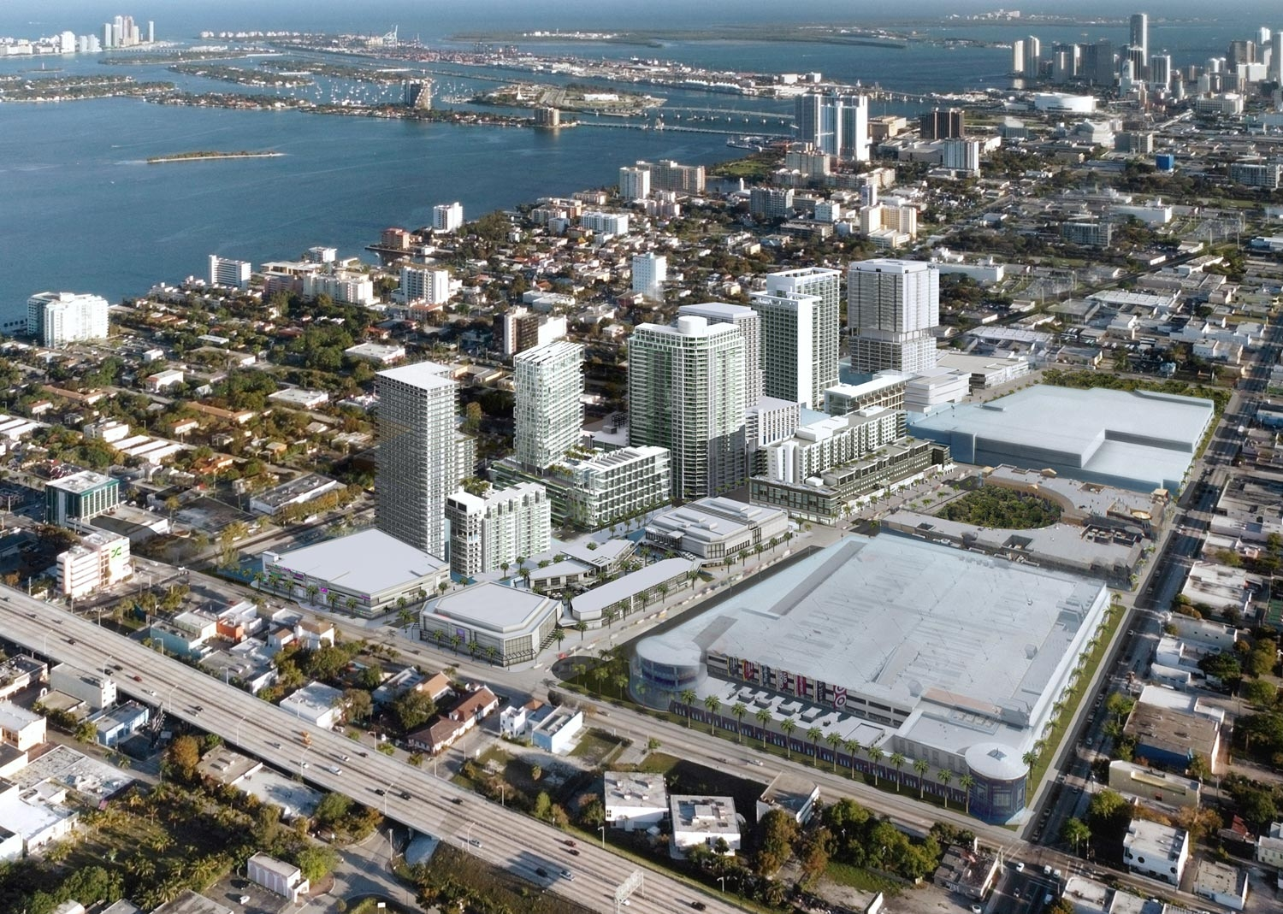
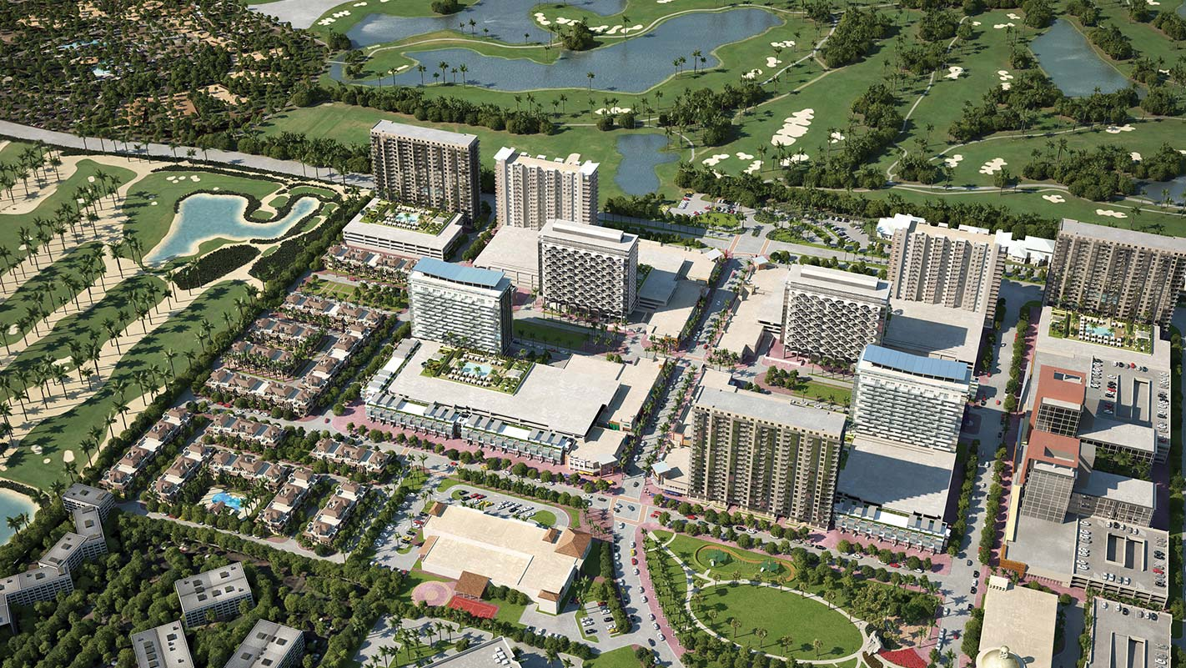
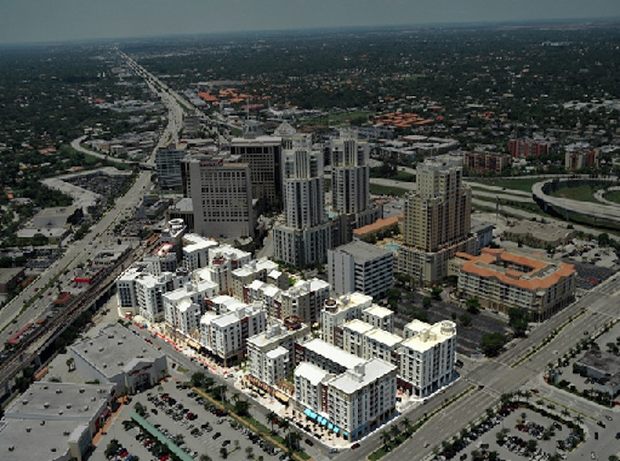
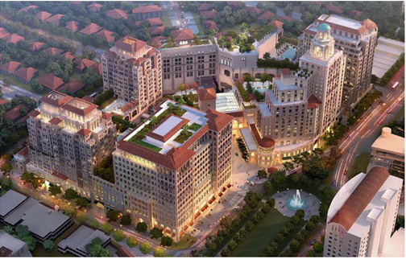
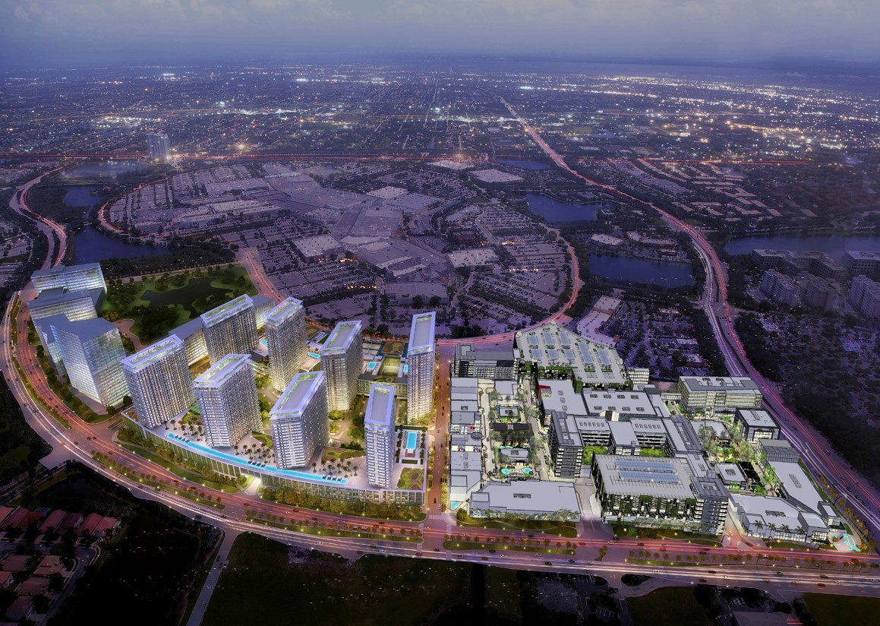
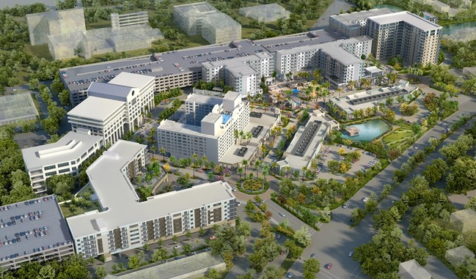
South Florida’s Emerging Live-Work-Play Urban Centers
South Florida Population Growth 230 per day
Or
83,950 per year
Midtown & Edgewater
Doral
Dadeland
Coral Gables
Sunrise
Plantation

Slide 33
The Future and X Factors
X Factors
Parking: Required vs Needed
Chinese Policies & Economy
Self driving cars
Inflation
Mass Transit Advances
Revenue Management Software & Dynamic Pricing
3D Printing (Construction Costs)
Unknown……….
Future Valuation
Interest Rates
Interest only terms future availability
Currencies & Exchange Rates Canada = largest foreign Commercial Real Estate investor
Yield and investment alternatives
Impact of new insurance rates to bottom line after destructive hurricane season
Regulations & Politics
New Fed Chairman
ECB & BOJ Policies
Mortgage Financing
Fannie & Freddie provide liquidity to multifamily
Policy changes for borrowers and homeownership
New Tax Regulations and their impact on Florida
Low tax State
Passthrough entities

Slide 34
2018 CCIM Commercial Real Estate Outlook Conference
January 17, 2018
Presentation By:
Peter Mekras, Managing Director
Aztec Group, Inc.
2665 South Bayshore Drive
PH 2 A
Coconut Grove, Florida, 33133
www.aztecgroup.com
Although the information contained herein is believed to be correct, Aztec Group, Inc. has not independently verified the information contained
herein and disclaims any and all responsibility for any inaccuracies. No representation or warranty, expressed or implied, is made as to the accuracy or
Completeness, or any other written or oral communication transmitted in the course of this presentation.

